Slide 1
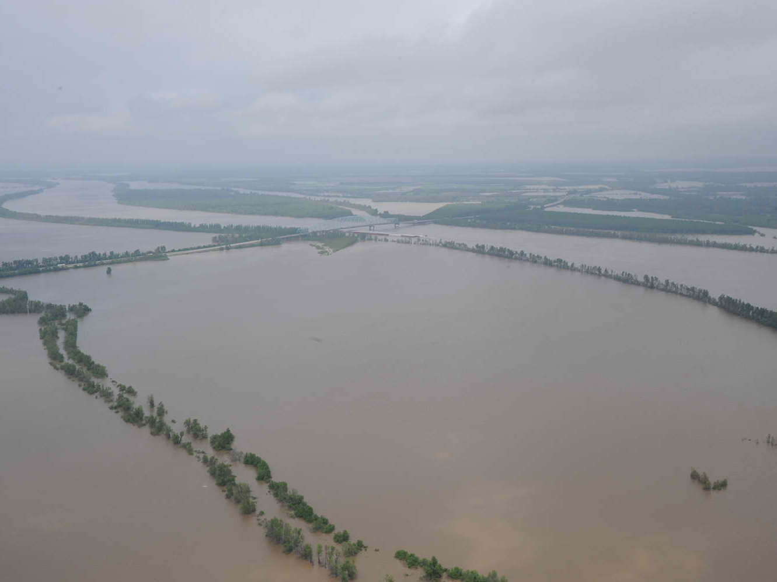
TEMPORARY CONNECTIVITY: A Comparison of the New Madrid Floodway and the Adjacent Main River
Quinton Phelps
West Virginia University
Morgantown, West Virginia
Sara Tripp, and Dave Herzog
Big Rivers and Wetland Field Station
Jackson, Missouri
James Garvey
Southern Illinois University
Carbondale, Illinois
Notes:
Riverine fish species have evolved migratory patterns and life-history characteristics to exploit seasonally predictable flood pulses and make use of resulting seasonal habitats and energy sources, particularly for reproduction, feeding, and refuge from intolerable conditions (Welcomme 1979; McKeown 1984; Petts 1989; Winemiller and Rose 1992; Scheimer 2000). Thus, seasonal use of floodplain habitats is common in river fishes worldwide (Welcomme 1979; Petts 1989; Winemiller and Rose 1992). As a consequence, large river fish communities utilizing the floodplain exhibit high diversity, through increased productivity…in terms of abundance and growth. Which is exactly what I am going to be discussing today….TITLE

Slide 2
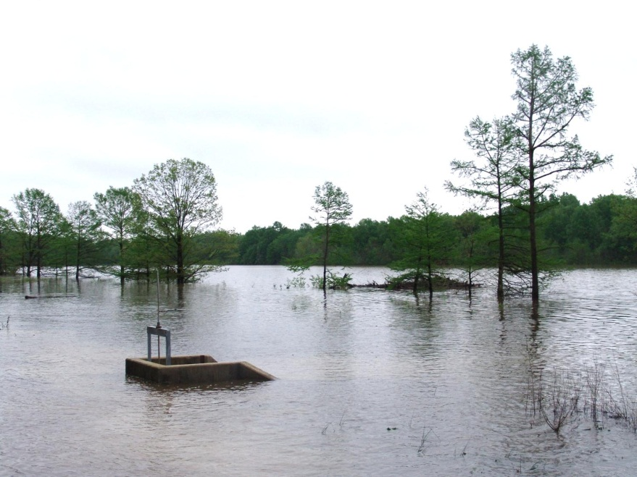
FPC Benefits Fishes
Of the multiple benefits to fishes, we are going to focus on three primary factors
Diversity
Density (i.e., relative abundance)
Growth (via tissue increase over time)
So…what do we know based on previous work? Well…
I’M SO HAPPY!
=
FLOODPLAIN CONNECTIVITY
Notes:
As I just suggested- floodplain connectivity is important to large river fishes…

Slide 3
But…..more specifically
Species Diversity increases with FPC
Multiple studies suggest lateral connectivity produces a range of lotic and lentic aquatic environments . Thus increasing the amount and type of habitat ….increasing niche availability and thus diversity

Slide 4
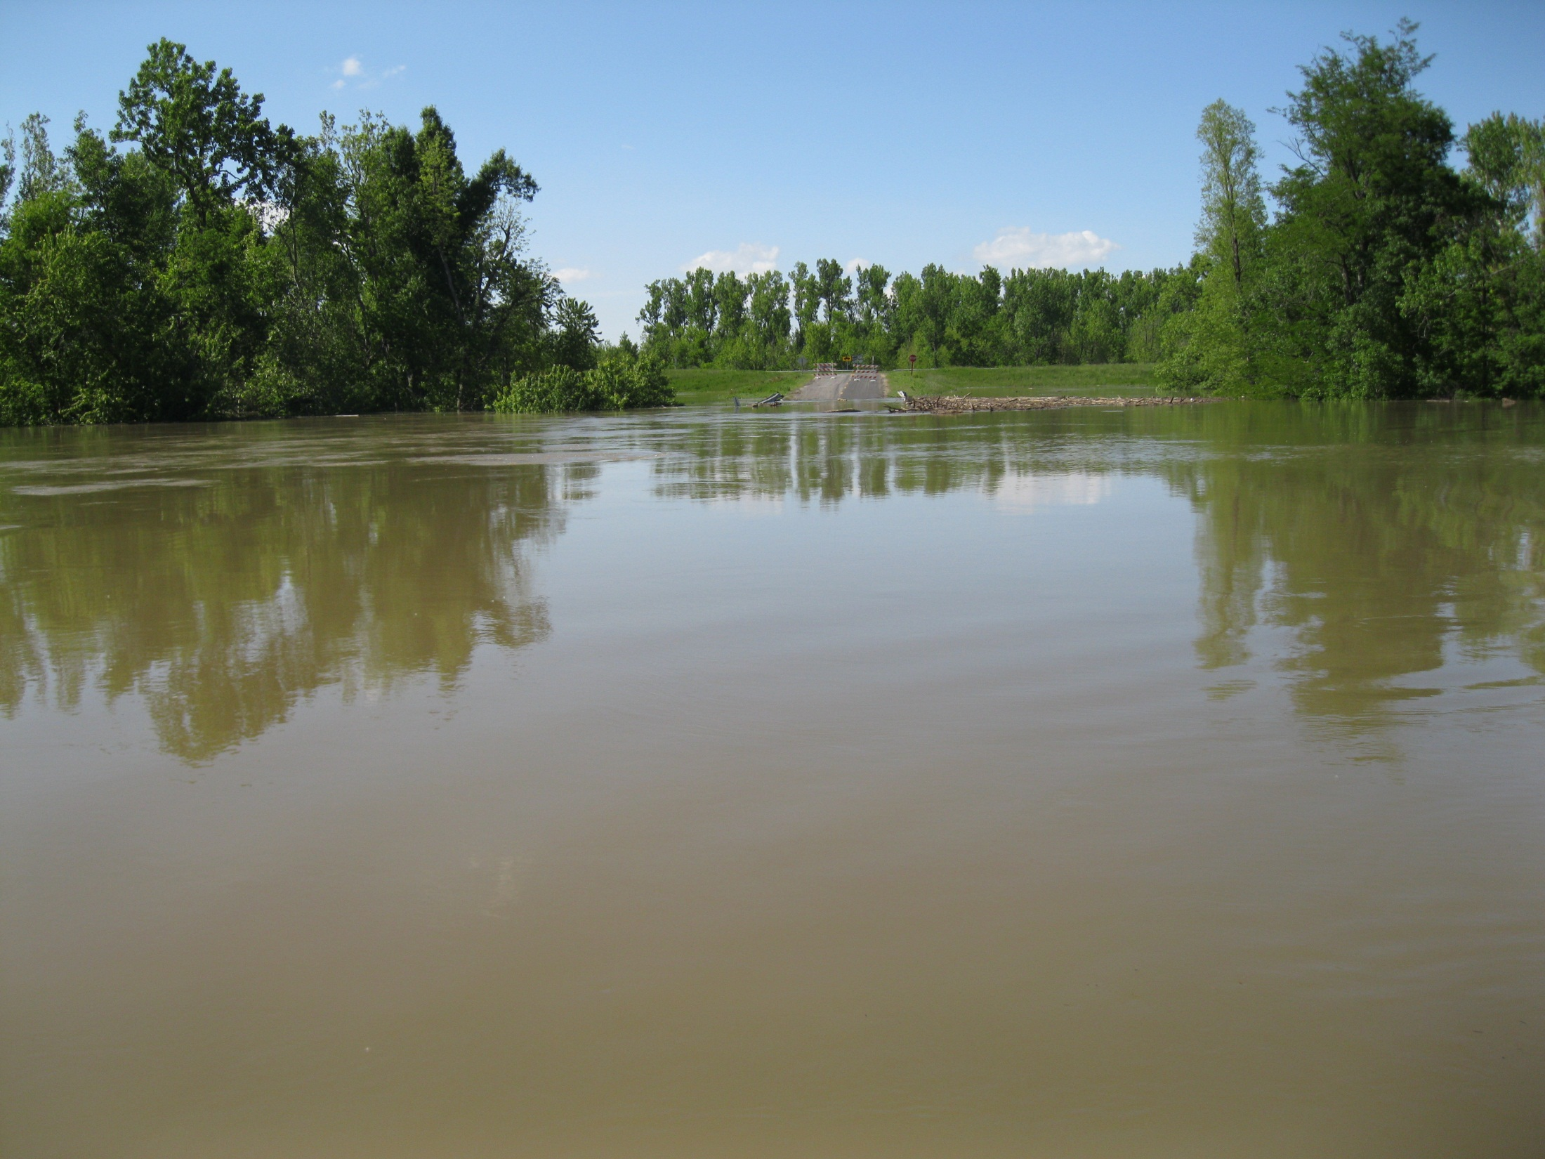
Density/Relative Abundance
Fish density higher in areas of floodplain connection
Several studies in N. America and beyond have observed an increases in abundance that corresponded to inundation of off-channel habitats.

Slide 5
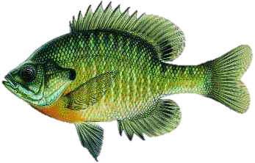
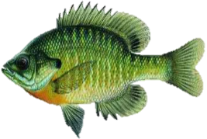
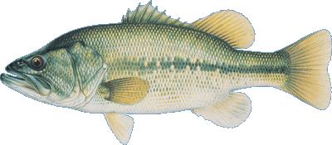
Growth
Fishes grow (in terms of tissue increases) faster in areas of off-channel connectivity
For example, several studies have demonstrated this including a foundational study in the Upper Mississippi River……..on near shore fishes
FLOOD
NONFLOOD

Slide 6
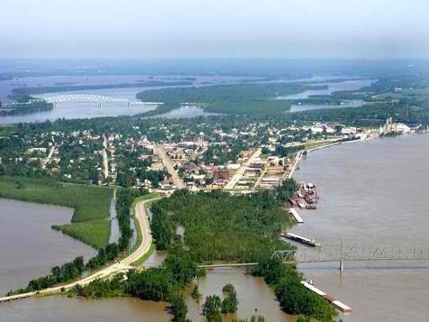
Despite the importance of FPC
Anthropogenic modifications on the Mississippi River (below Alton, IL) have largely disconnected the floodplain from the adjacent river.
These anthropogenic processes have been put in place to maintain navigation, increase agriculture production, and prevent flooding.

Slide 7
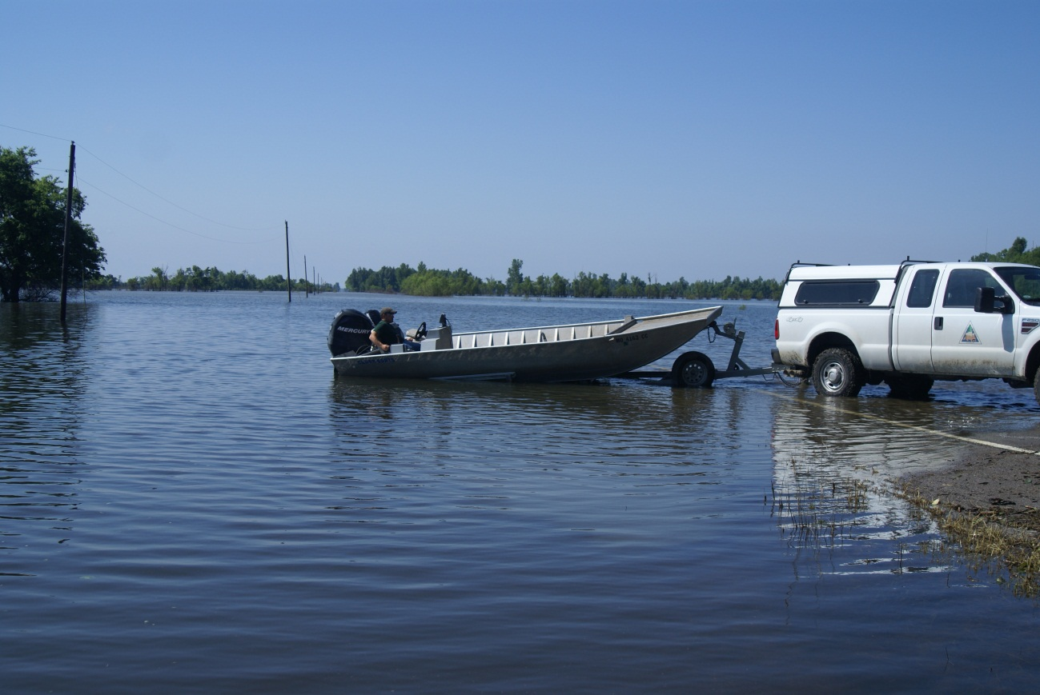
HOWEVER,
Despite the best efforts to control the river through many modifications…..During late May through early October 2011, we were provided an unprecedented opportunity to evaluate the relative importance of floodplain connectivity in the New Madrid Floodway.

Slide 8
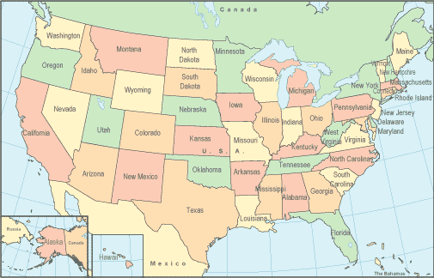
Where is the New Madrid Floodway?
The New Madrid floodway is positioned on the west bank of the Mississippi River, directly below the confluence of the Mississippi and Ohio Rivers.
This area is a broad expanse of former floodplain on the Missouri side of the Mississippi River.
The NM Floodway allows water to move laterally rather than remaining constricted within the confines of the leveed main channel.
This connectivity reduces gauge heights upstream and downstream of the floodway. Thus reducing flood risk in urban locations.
NEW MADRID FLOODWAY

Slide 9
Floodway Design
The floodway was created in 1927 using a 58-km secondary levee (on the east; outlined in black). At the upstream end, the primary and secondary levee meet.
At the southern (downstream) end, near New Madrid, a 500-m gap separates the ends of the two levees, channelizing the floodwaters back into the main channel.
Illinois
OHIO RIVER
MISSISSIPPI RIVER
Cairo, IL
Missouri
Kentucky
FLOODWAY
MISSISSIPPI RIVER
New Madrid, MO
Tennessee

Slide 10
In times of record river stages in the OH and MISS rivers
The USACE standard operating procedure is to use explosives at three strategically placed locations (red asterisks) along the primary levee to inundate the floodplain and thus reduce flood risk.
Which is exactly what happened during 2011 (inundating 130K acres).
Illinois
OHIO RIVER
MISSISSIPPI RIVER
Cairo, IL
*
Missouri
Kentucky
FLOODWAY
MISSISSIPPI RIVER
New Madrid, MO
*
*
Tennessee

Slide 11
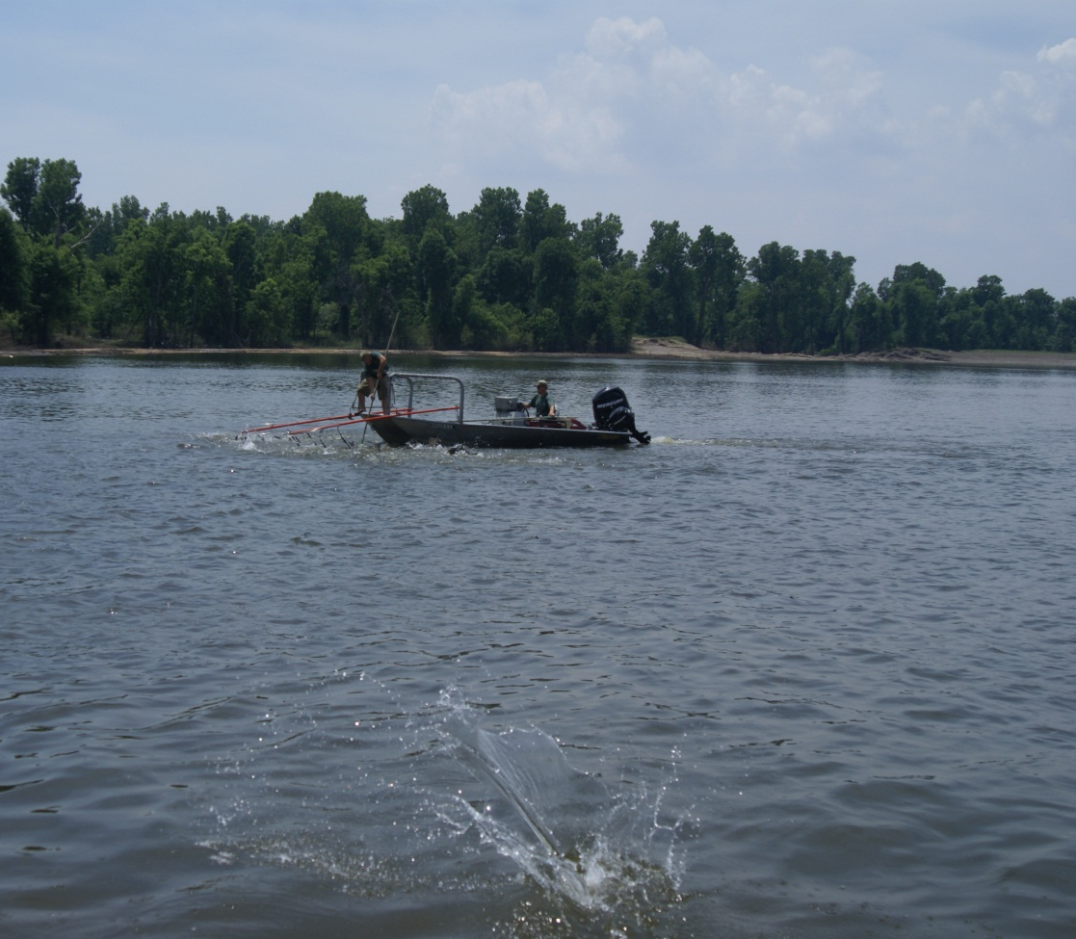
Now that we have this water ….Now what?
Because of the purported benefits of FPC, there is only one thing to do…..
BIOLOGICALLY EVALUATE!!!!
Ho: Diversity, relative abundance, and growth would be similar between the floodplain and the adjacent main river
Ha: Diversity, relative abundance, and growth would differ between the floodplain and the adjacent main river

Slide 12
Objectives
Our objectives followed our hypotheses:
Specifically, we sought to compare diversity, relative abundance, and growth between the floodplain and the adjacent main river.
Ultimately, these data will provide additional insight into floodplain connectivity and the relative influence on large river fishes.

Slide 13
Methods
Sampling commenced in late May and ending in Early October
Bi-weekly we randomly sampled across strata (U,M,L) at 5 off-channel locations with electrofishing and 5 with bottom trawling. This sampling regime was conducted in the floodplain and main river.
Based on our design and duration of inundation (20-weeks), the total sampling effort was
50 EF samples Floodplain
50 MT samples Floodplain
50 EF samples Main River
50 MT samples Main River
In some areas sampling locations were inaccessible (due to lack of water or safety concerns), thus, we sampled other available randomly selected locations.
Illinois
OHIO RIVER
MISSISSIPPI RIVER
Cairo, IL
UPPER
Missouri
Kentucky
LOWER
FLOODWAY
MISSISSIPPI RIVER
New Madrid, MO
MIDDLE
Tennessee

Slide 14
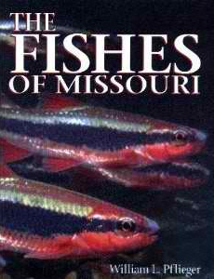
Methods continued….
At each sampling site…
Depth, velocity, and substrate were recorded.
All fishes were identified, enumerated, and measured for total length.

Slide 15
Data Analyses
Shannon-Wiener Index was used to compare diversity between the floodway and adjacent river.
For comparing density (via relative abundance) of the most dominant species between the floodway and adjacent river, we used standardized catch per unit effort (SCPUE) was calculated using number of fish/min trawled or electrofished.
Growth (tissue increase) was assessed by following cohorts of the most dominant species over the course of our evaluation (Braaten et al. 2008). Comparisons of growth were assessed between locations.

Slide 16
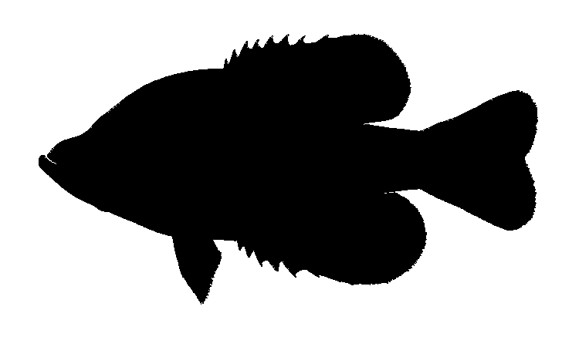
89 Species combined FP & MR (May-Oct)
Many of conservation concern…Majority captured in shallow low velocity habitats
Notes:
Over the course of our evaluation (late May through early October) in both the floodplain and the adjacent main river:
Sidenote:
As a qualitative measure of habitat use: The majority of fish captured were in low velocity shalow areas.

Slide 17
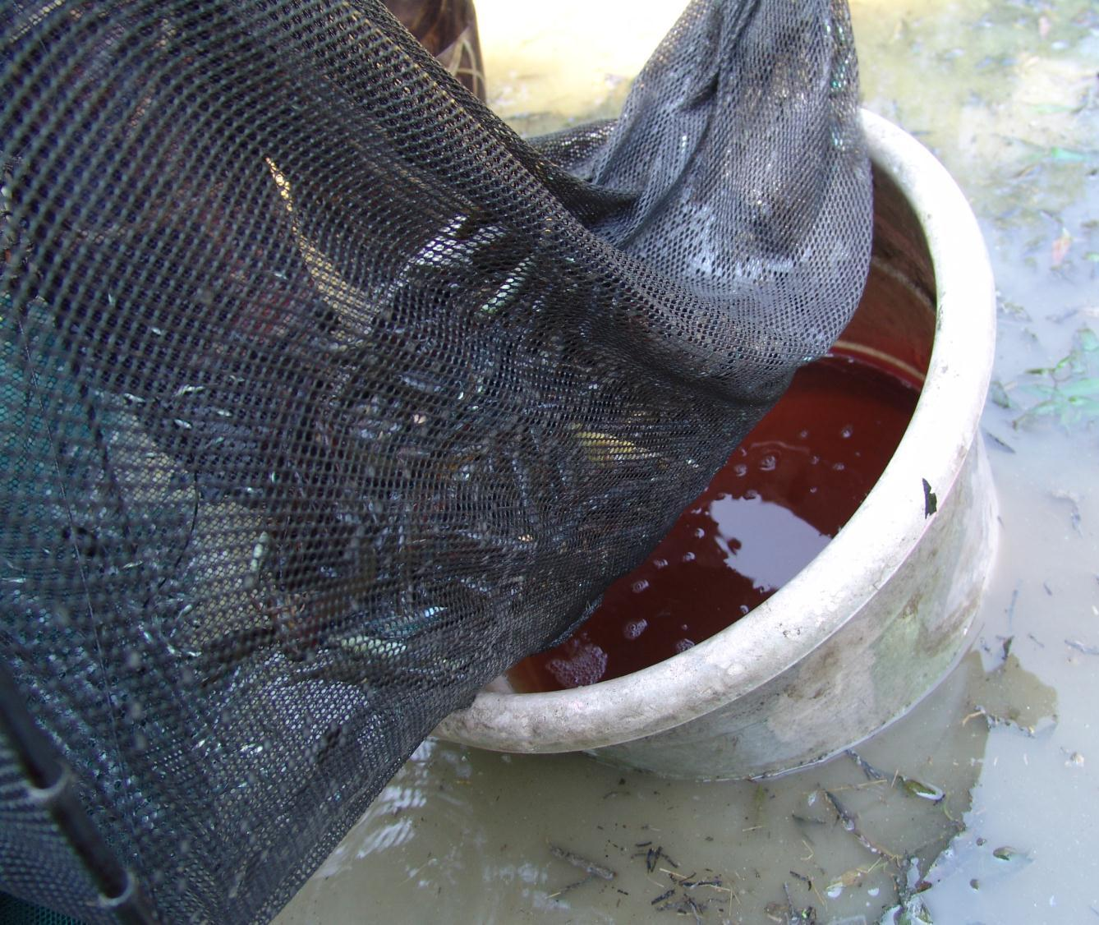
Floodplain
The majority of the fishes were captured in the floodway constituting a total of 14,276 Fishes representing 86 species –Majority of fish captured were small (YOY/Juvenile)
Dominant Species Gizzard shad (highest total catch), silver carp, freshwater drum, and channel catfish
Noteworthy species-
We captured YOY Scaph sturgeon,
paddlefish, and four species of invasive carp….plus many YOY centrarchids, moronids, sauger

Slide 18
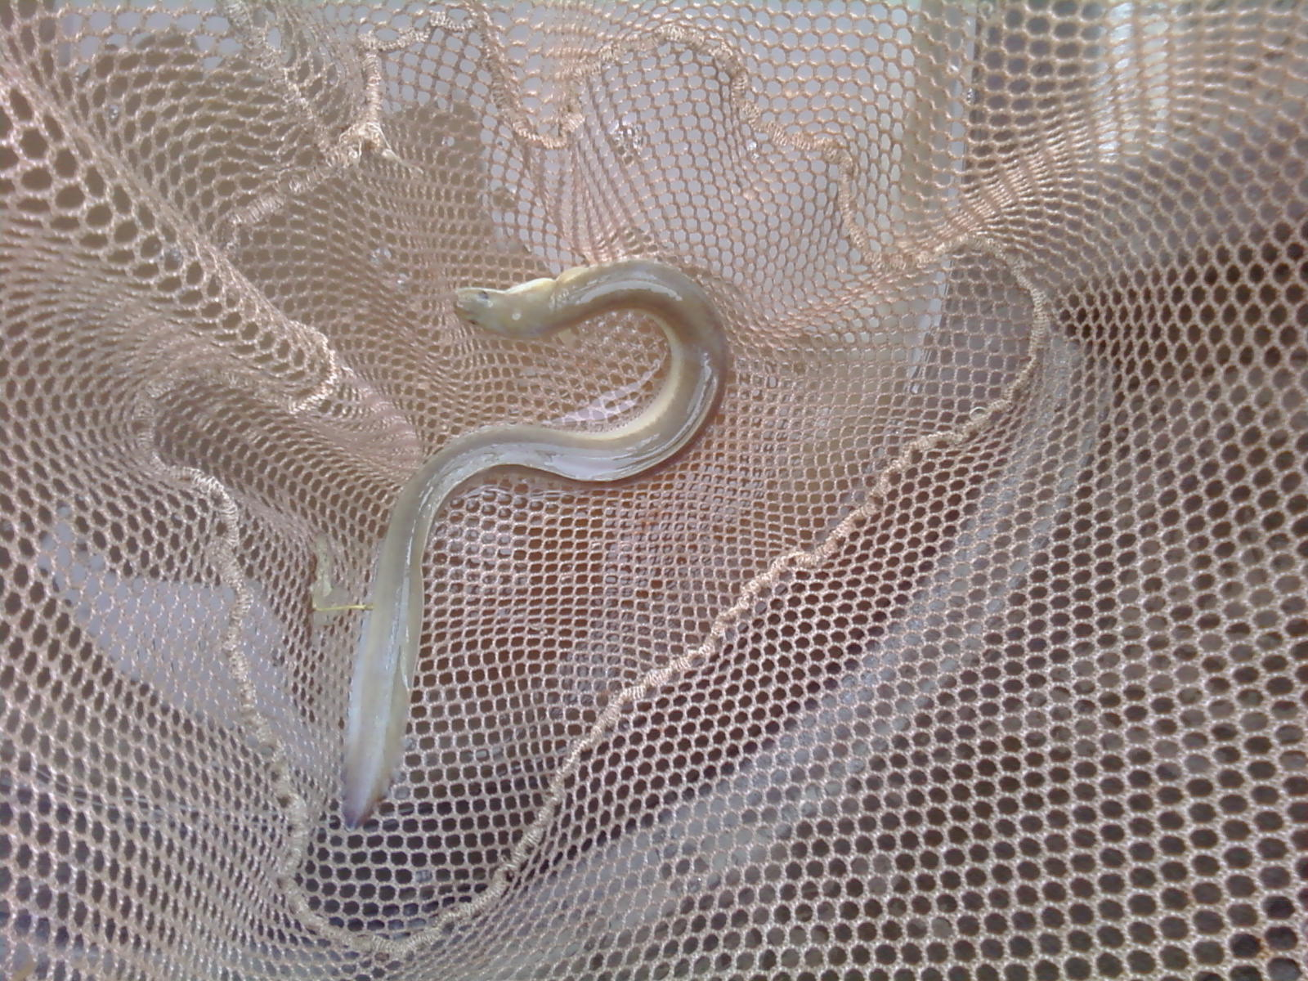
Main River
In the adjacent main river, we captured 4,766 fishes consisting of 62 Species
Dominant species were silver carp (highest total catch), gizzard shad, channel catfsh, and freshwater drum
Noteworthy species-
Lots of sturgeon and pdfh
Harlequin Darter, American Eel

Slide 19
Diversity
Floodplain diversity index 2.31
Main river diversity index 1.99
This suggests that inundation of the floodplain may increase diversity
We don’t know whether the fish are moving to these areas to gain refuge or if they are selecting these areas….

Slide 20
Density
Floodplain density
Gizzard Shad 14.39 /min
Silver Carp 4.13 /min
Freshwater Drum 6.89/min
Channel Catfish 0.14 /min
Main River density
Gizzard Shad 0.81/min
Silver Carp 3.81 /min
Freshwater Drum 0.56 /min
Channel Catfish 1.73 /min
Given the catch rates of the most dominant taxa (except channel catfish), the floodplain exhibits higher density than the main river.
Note: Silver carp relative abundance similar between main river and floodplain

Slide 21
Growth
Floodplain
Gizzard Shad 2.85mm/d
Silver Carp 2.5 mm/d
Freshwater Drum 1.49 mm/d
Channel Catfish 0.72 mm/d
Main River
Gizzard Shad 1.42 mm/d
Silver Carp 2.5 mm/d
Freshwater Drum 0.95 mm/d
Channel Catfish 0.46 mm/d
Given the faster growth rates of most of these floodplain fishes …this may lead to higher survival and eventual recruitment as opposed to their slower growing main river conspecifics.
Note: Silver carp growth rates similar between MR and FP
TIME

Slide 22
SO….TO WRAP THIS UP!
Based on the results uncovered in this study….
We collected 89 species (conservation concern, recreationally important, commercially important)
Fish Community Diversity higher in the FP than MR. Majority of fish captured in the FP were YOY/Juveniles- while the MR had a good mix of adult, juvenile and YOY fishes. YOY Sportfish abundance much higher in FP than MR. Although YOY SNSG and PDF were primarily collected in MR samples but both spp. were also captured in the floodplain.
As for the most dominant species, the floodplain tends to have higher density and growth than the adjacent river. However silver carp density and growth were similar between locations.

Slide 23
In Conclusion…
Similar to other studies …diversity, density, and growth higher on the FP than in the MR. These advantages must be weighed against disadvantages (effects on humans)…need to find a balance!!!
FP
MR

Slide 24
Acknowledgments
We would like to acknowledge that this study was funded by the U.S. Army Corps of Engineers’ Upper Mississippi River Restoration - Environmental Management Program’s Long Term Resource Monitoring component implemented by the USGS Upper Midwest Environment Sciences Center and performed by Missouri Department of Conservation.

Slide 25
In Conclusion…
Similar to other studies …diversity, density, and growth higher on the FP than in the MR. These advantages must be weighed against disadvantages (effects on humans)…need to find a balance!!!
FP
MR

